Slide 1
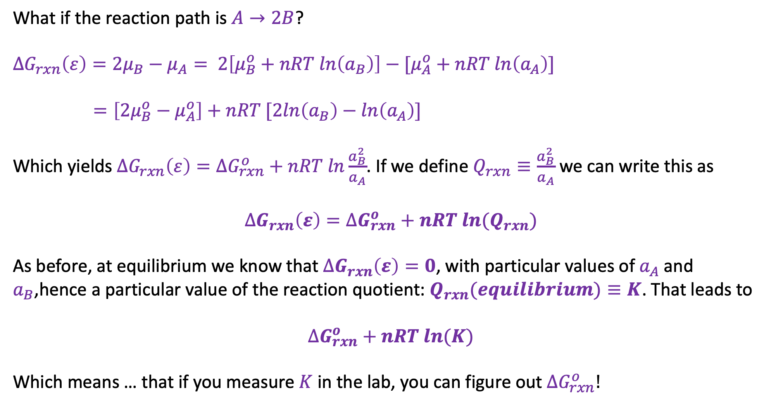
How $∆G_{rxn}(ε)$ depends on reaction stoichiometry
What if the reaction path is $A→2B$?
$$∆G_{rxn}\left(ε\right)={2μ}_{B}−μ_{A}= 2\left[μ_{B}^{o}+nRT ln\left(a_{B}\right)\right]−[μ_{A}^{o}+nRT ln\left(a_{A}\right)]$$
$$=\left[2μ_{B}^{o}−μ_{A}^{o}\right]+nRT [2ln\left(a_{B}\right)−ln\left(a_{A}\right)]$$
Which yields $∆G_{rxn}\left(ε\right)=∆G_{rxn}^{o}+nRT ln\frac{a_{B}^{2}}{a_{A}}$. If we define $Q_{rxn}≡\frac{a_{B}^{2}}{a_{A}}$ we can write this as
$$∆G_{rxn}\left(ε\right)=∆G_{rxn}^{o}+nRT ln{(Q}_{rxn})$$
As before, at equilibrium we know that $∆G_{rxn}\left(ε\right)=0$, with particular values of $a_{A}$ and $a_{B}$,hence a particular value of the reaction quotient: $Q_{rxn}(equilibrium)≡K$. That leads to
$$∆G_{rxn}^{o}+nRT ln(K)$$
Which means … that if you measure $K$ in the lab, you can figure out $∆G_{rxn}^{o}!$

